Slide 1


commtechmessenger // emergency services solutions

Slide 2


mission critical messaging for mobile professionals
commtechmessenger // emergency services solutions

Slide 3
About Commtech Wireless Internationally
Representation / Offices in
  Asia Pacific – Australia (Development Office)
  Europe – Denmark / Germany
  Africa – South Africa (Message Systems)
  United States – Florida (Head Office)
International Dealer Network
  Estimated 600⁺ accredited dealers globally
  Racom Systems – accredited dealer Cape Town
Australia Largest Manufacturer of Wireless Messaging Infrastructure
Over 6000 system installations across 53 countries
Award Winning Technology
Internationally Approved, Tried and Tested for Mission critical and other key apps.
Notes:
1: Relationships internationally

Slide 4
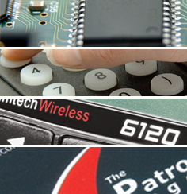
What Does Commtech Develop ?
Advanced Messaging Systems
Firmware Rack & Desktop Systems
Paging Terminals
Encoders
Transmitters
Pagers and Paging Receivers
Alarm Monitoring Equipment
Telemetry Systems
OVER 2MIL USD in R&D + Product Dev P/A

Slide 5
For Which Industries Do We Provide Messaging?
Healthcare
Hospitality
Restaurants
Industrial
Emergency Services
Casino / Clubs
Military
Notes:
1: Why Synchronous Paging for Mission Critical messaging ? vs Other messaging systems.
2: Integrated with Other systems

Slide 6
Commtech Messenger - System Key Benefits
Stability of System is independent of other third parties
Self owned mission critical networks are:
Independent of Commercial failures
Deterministic (Complete control of delivery)
Isolated from major & minor events impacting public
communications networks
Major catastrophes: 911 and London Bombings
Minor incidents: Traffic jams / bomb scares / publicity events
Communication traffic priorities managed directly by System owner
Capability to Integrate with wide range of comms systems
Expandable / upgradeable

Slide 7
Case History Statistics and Examples in Catastrophic Events
London Bombings:
  250% increase in mobile call volumes
  Normal fixed line carriers experienced double traffic
  In a 1km radius of bombings in 5hrs - 1 Million calls attempted
  Emergency services with own paging systems unaffected
New York 911:
  Widespread infrastructure damage to public systems
  Significant increase in SMS traffic resulting in variable delays and non delivery of SMS messages
Hurricane Katrina - USA:
  Most paging services withstood hurricane
  Damaged paging systems were restored faster than PSTN, cellular and broadband networks
  In areas hardest hit paging services were restored in 48hours

Slide 8
Case History Statistics and Examples (cont…)
Victoria State Government – Australia:
  Operate aprox. 190 paging transmitter network
  Spent an estimated $100M to implement
  Dedicated use for emergency service communication
Dutch Government – Netherlands:
  Implemented a national paging network for all emergency services
  Network operates 30,000 pagers
Michael Cassidy, president of the London Chamber of Commerce, reinforced this point (critical role paging played) in an article in the Times soon after the July 7th attacks in London, Cassidy commented "...firms needed to be able to communicate through a secure paging system in the event of further attacks...”
London Regional Resilience report Post July 7th attacks 2005:
''Pagers: so long as they are sufficiently independent of other networks, consider using pagers for alerting and mobilisation, including preset pager groups, where this function is critical'‘
“Pagers: They can enable messages to get through when mobile phone networks are congested. COLP (City of London Police) successfully used its pager alert scheme on 7 July to provide key business personnel with incident progress information.”

Slide 9
Technology Overview for Emergency Network
Private synchronous wide area paging network:
  Overlapping radio coverage gives inherent redundancy
  Broadcast communication capability
  - efficient band width usage
  - fastest possible means to communicate with numerous recipients
Private Multi-link IP Communication Backbone:
  Not affected by individual link failure or external traffic fluctuations
  Providing reliable inter-site connectivity (essential for private paging)
Telephony (PSTN & PABX) Limitations:
  If a combination of both is utilized, a more reliable access to an EMS communication system results for telephone page message dispatch
Mobile / cellular (Data, SMS & Voice) Limitations:
  Easily congested due to localized incidents
  SMS messages may remain in the system for up to a number of days (not guaranteed delivery)

Slide 10
Private Synchronous Paging Services
Private Synchronous Wide Area Paging Network - illustrating redundancy in Coverage and Links

Slide 11

system overview //CommtechMessenger

Slide 12
What Is Unique About Commtech Messenger?
Seamless integration of ALL forms
of messaging
Commercial grade client / server architecture
True Multi-user messaging platform
Simple, scalable and secure interface
Link multiple sites together via Internet
Administer the system over the Internet
Dual Redundancy of messaging system
Wireless messaging and Private Paging system on a single platform/ network
Notes:
Seamless integration of ALL forms of messaging – Acknowledge and Cancel Calls
Commercial Grade Client / Server Architecture – Rock Solid Performance Assured
True Multi-user and Fully Integrated System – One Platform for Everything Rather Than Dozens of Separate Applications with Unrelated Databases
Simple, Scalable and Secure Interface – Simplify the System so a User Only See What they Need to See, or What You Want Them to See
Link Multiple Sites Together via Internet – Link External Systems into a Common Platform Without Software Development
No Limit to Ports or Groups –Unlimited Port Capacity, As Well As Unlimited Number of Recipient Groups
Touch Screen User Interface for Nursecall Allocation
Administer the System Over the Web Using the Web Client – No Need To Open or even Install the Client, or the Server.
Onsite Paging System and Wireless Integration – Replaces Both of These Systems in One Solution

Slide 13
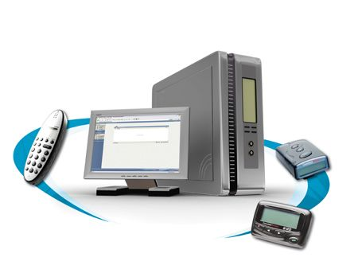
Commtech Messenger Features Cont…
Multi-device messaging - sends messages to Wireless Devices
  Pagers / TETRA / WiFi / DECT
  SMS (PDA’s, Cell Phones)
  Email
  LED / Traffic Control Signs
Control / Monitor devices via Serial Comms / IP Interface / Remote Switches
Monitors internal event management systems including;
Telemetry Systems, IT Networks, Fire, BMS, Access Control, HVAC, Security

Slide 14
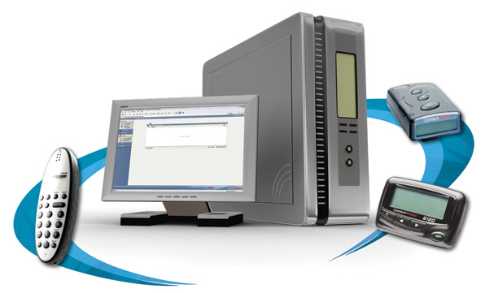
Commtech Messenger Interfacing Overview
Messenger manages the messaging of critical events to the right staff
Enables management of service levels
Assists Management to ensure critical events are properly dealt with and closed
Gives access to information of when messages were sent & what the message was
Closed loop messaging via Messenger Escalation feature
Areas of application:
IT Network Monitoring
Electric Power Supply Monitoring
Telemetry Systems
Emergency Services
Traffic Control
Monitoring / Controlling Remote Equipment

Slide 15
Commtech Messenger – Total Solution
web interface
multi sites / clients
scheduling
statistics
components of commtechmessenger
SMS
equipment
machines
LED signs
wireless telephony system
wide area paging
commtechmessenger
printer
alarm management
(Gas, ICU, IT, security, fire and evacuation, building management and telemetry)
PBX interface
email interface
alarm monitoring

Slide 16
Commtech Messenger – Multi TX Site Layout

Slide 17
Options for System Modular Layout & Expansion
Control Centers – High Sites – Recipients – User Log-on
Notes:
1: Redundancy
2: Range of solutions depending on site requirements
3: Central Control Module ? For bigger sites.

Slide 18
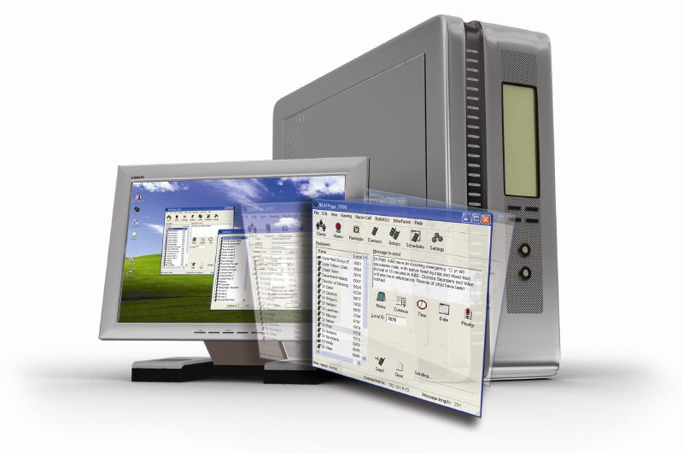
The Software
Commtech Messenger

Slide 19
initiating messages //CommtechMessenger

Slide 20

Multi-user Environment
Any PC may update any aspect of the system
Users may log on the server from any PC
Security specifies what facilities may be accessed
All operations may be performed via the Internet

Slide 21
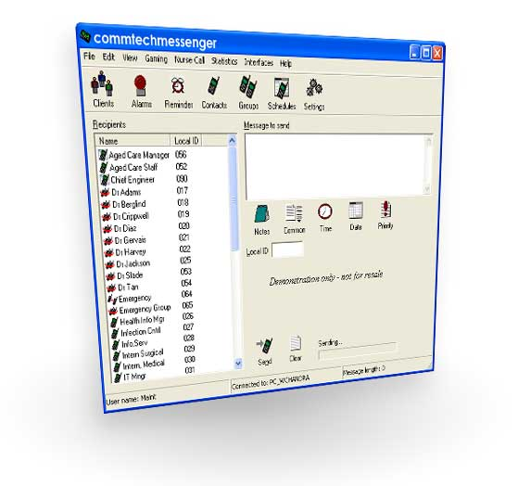
LAN Message Dispatch
Messages may be dispatched from any PC
Search by name or recipient ID
One click message history
Messages may be prioritized for emergency situations
Common messages for quick dispatch of frequently used text

Slide 22
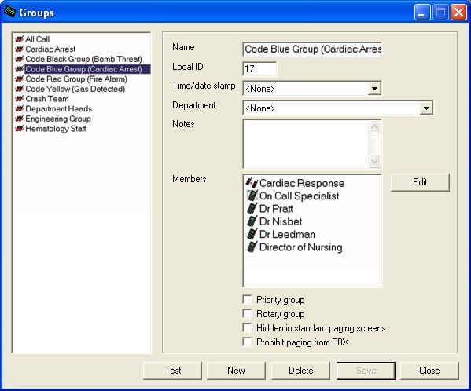
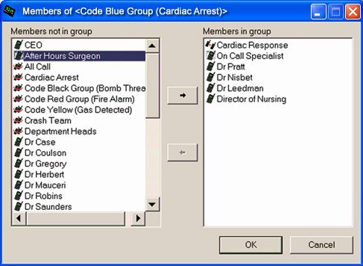
Intuitive User Interface
Recipient divert & availability management features
Hot key shortcut messaging

Slide 23
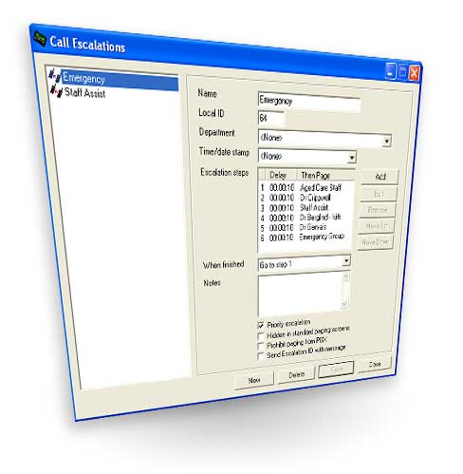
Escalation Paths
Alarms escalate until resolved
Escalate to individuals / groups on pager / SMS
Recipients may respond via PBX to stop escalation
Configurable escalation times
No restrictions on escalation paths (steps, groups, devices)

Slide 24
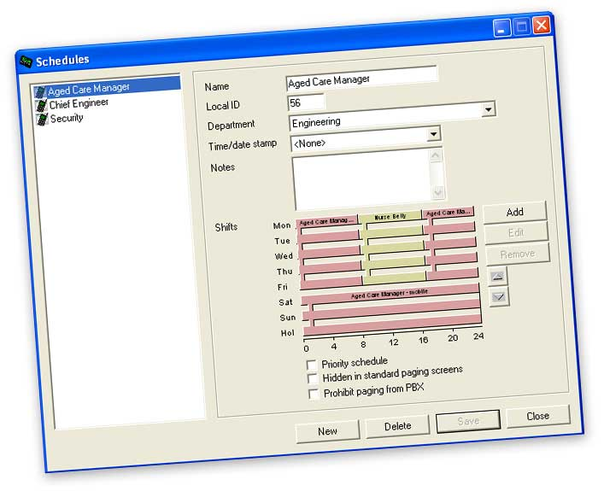
Scheduling System
Contact different staff or devices depending on the time of the day and the day of the week
Schedules may be assigned to any event
Customizable Public Holidays

Slide 25

Booked Calls - Reminders
Scheduled reminder messages
Able to send to any wireless device or group
Able to be modified from any client

Slide 26

PBX Integration
Send alphanumeric and numeric messages
Can page recipients, groups, rosters or escalation paths
Voice-prompted
Priority calls
Can use Wireless Telephone

Slide 27

SMS Message Initiation
Messages sent from any mobile to any recipients / groups on system
Carrier independent
SMS to pager / email etc
SMS initiation of escalations

Slide 28
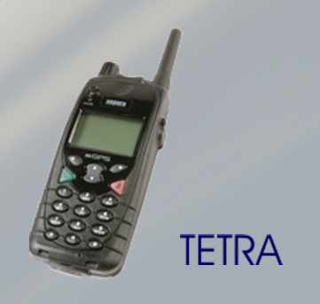
TETRA Integration
Send text messages to TETRA handsets
Initiate messages from handset to any other device on system: SMS, email
Messages can be sent to groups / schedules / escalations from your TETRA handset

Slide 29

Email Message Initiation
Send email to System to initiate paging / SMS messages
Messages can be sent to groups / schedules / escalations
Assign an email address to any wireless device – including wireless handsets!

Slide 30
message receipt //CommtechMessenger

Slide 31

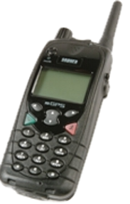
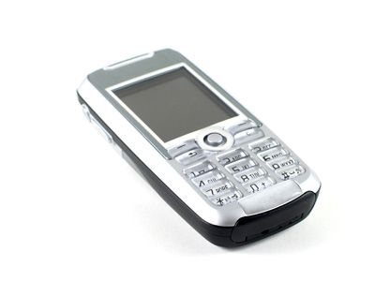
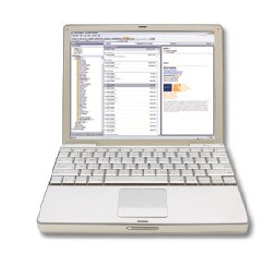


Device Independence
Automatic dispatch of messages regardless of recipient device
wireless telephones
DECT
TETRA
on-site / wide area paging
Multi-site Roaming
Independent Sites
cell phone
SMS
email
LED Display
Messages can be sent to remotely control devices like :
  Software Applications / Computers / Generators / Lighting

Slide 32

Private Synchronous Paging Network
Free message delivery
Ultra fast message dispatch (typically 2 seconds)
Prioritized messages
Full Site Coverage –
inter system networking allows paging between hospital sites

Slide 33
SMS - Mobiles
Messages received even when staff members are not in coverage area
Message splitting
Carrier independent

Slide 34
Email
Receive copies of paging / SMS messages on normal email client (Outlook)
Alarms may escalate to email for management to monitor service levels
Monitor email received – be alerted wirelessly (pager /SMS)

Slide 35
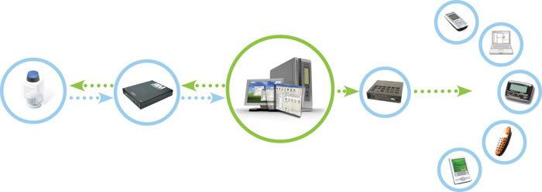

Alarm/ Incident Monitoring
PDA
email
pagers
Alarm
Security, BMS,
fire & evacuation, & telemetry
alarm monitoring
transmitter
commtechmessenger
Serial / IP
Comms
TETRA / DECT
mobile phone
IT Components / Servers
Hardware & Devices
Power Generators
Other Applications & Devices
IT Network Monitoring Software, Telemetry Systems

Slide 36

Linking Hospitals / Organizations Together
Hospitals may be connected together over IP connections
Messages are sent to devices at all locations
Seamless dual redundancy – servers located at different sites

Slide 37
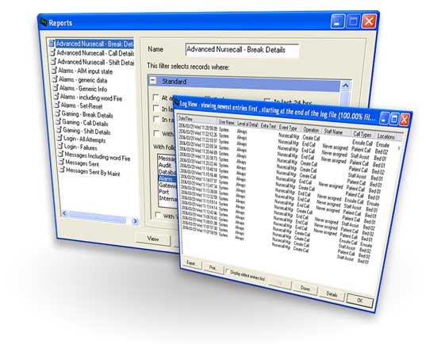
Message History & Reporting
Permanent log of all messages in data base
Reporting application client for standard reports
Open data base access for any reporting software
Solve disputes on when and to whom messages were sent
In the even of internal auditing you can easily review what happened during a particular time period
Audit trail maintains a log of who modified the system

Slide 38
additional optional functionality //CommtechMessenger

Slide 39
end of presentation
Thank you for your time and participation in this presentation

Slide 40

end of presentation
Thank you for your time and participation in this presentation

